Slide 1

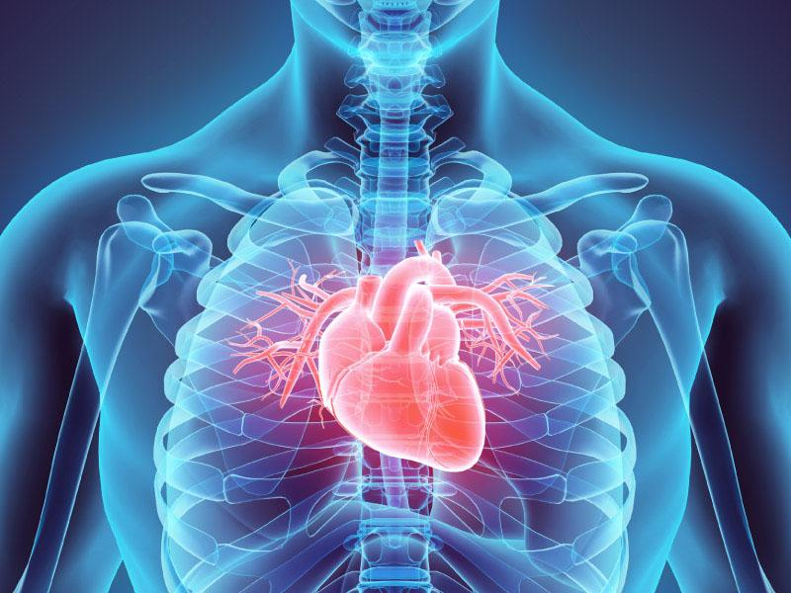
ITCS227 Introduction to Data Science
Heart Disease Prediction
6688011 Kittipob Bumphen
6688018 Nonthapath Chaworanum
6688027 Yuhan Huang
6688113 Duangwang Srisa-ard
6688232 Xinyi Chen

Slide 2


Introduction
Methodology
Result
Future Work
CONTENTS

Slide 3
01
Introduction

Slide 4

1.1. Global Impact of Heart Disease
ref: Cardiovascular diseases (CVDs)
Cardiovascular diseases (CVDs) are the leading cause of death globally.
An estimated 17.9 million people died from CVDs in 2019, representing 32% of all global deaths. Of these deaths, 85% were due to heart attack and stroke.
Over three quarters of CVD deaths take place in low- and middle-income countries.
Out of the 17 million premature deaths (under the age of 70) due to noncommunicable diseases in 2019, 38% were caused by CVDs.
Most cardiovascular diseases can be prevented by addressing behavioural and environmental risk factors such as tobacco use, unhealthy diet and obesity, physical inactivity, harmful use of alcohol and air pollution.
It is important to detect cardiovascular disease as early as possible so that management with counselling and medicines can begin.

Slide 5
1.2. Role of Machine Learning
Early Detection & Risk Assessment
Machine learning models analyze medical data to detect early signs of heart disease.
Predicts a patient’s risk based on historical health records, allowing early intervention.
Reducing Healthcare Costs
Early detection reduces hospitalization rates and treatment costs.
Automates routine diagnostic tasks, saving time for healthcare professionals.
01
02

Slide 6
1.3. Project Objectives
Use data science skills to analyze reasons for heart disease
Build a model for prediction

Slide 7

02
Methodology

Slide 8



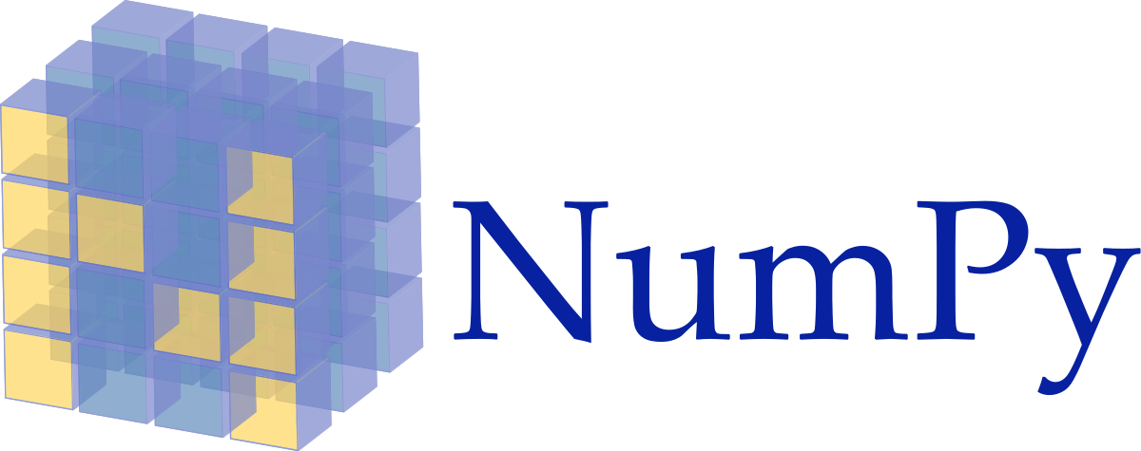





2.1. Develop Environment and Tools
Develop Environment
VScode
Ubuntu 22.04 (wsl)
Python 3.X
Tools
Numpy
Seaborn
Pandas
Matplotlib
Scipy
Sklearn

Slide 9
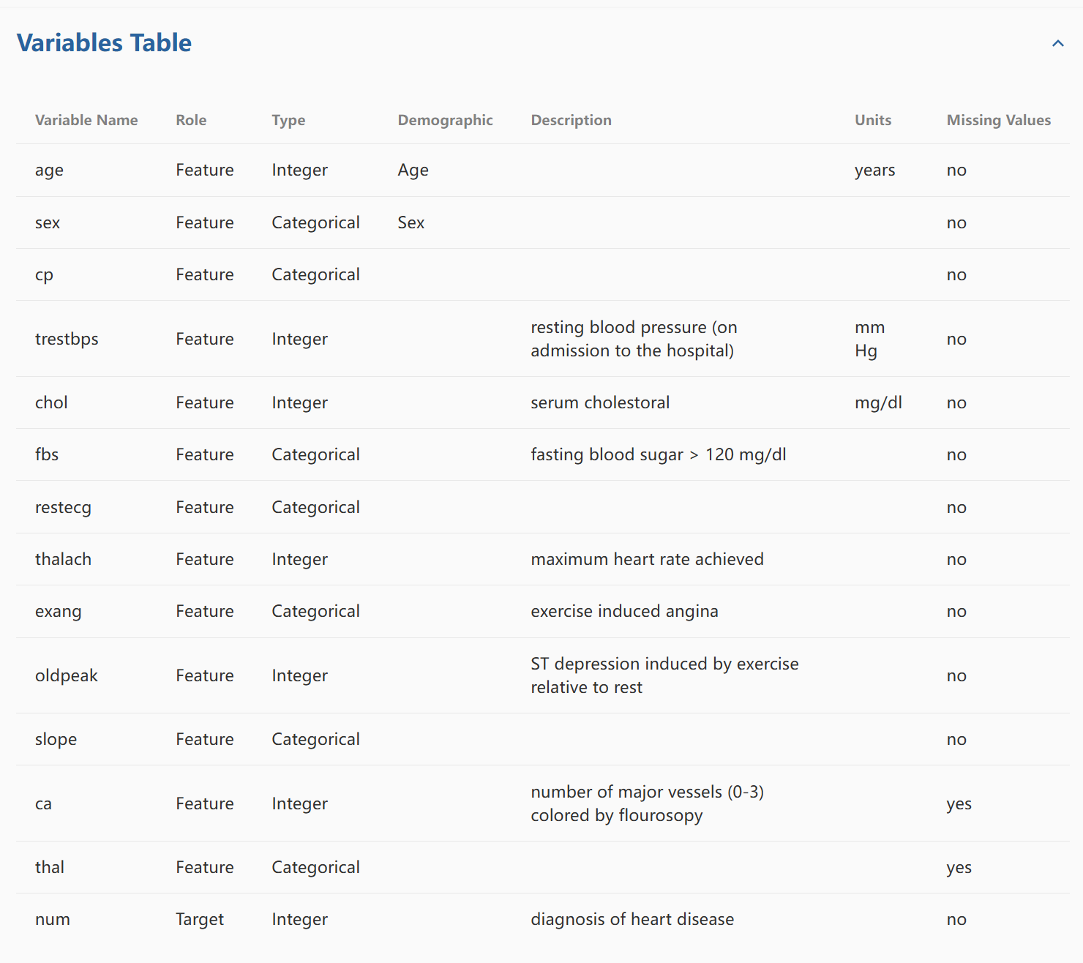
2.2. Data acquisition
Data source: Heart Disease - UCI Machine Learning Repository
Data Information: The Cleveland database contains 76 attributes, but only 14 are used in experiments, mainly for distinguishing the presence (values 1-4) or absence (value 0) of heart disease. The database has had patient names and social security numbers replaced with dummy values.
Dataset size: 59.2 KB
Use the UCI Heart Disease Dataset, which includes patient demographics and medical history.

Slide 10
2.3. Data Preprocessing
1. Handling Missing Value
‘ca’: 1.32% missing
‘thal’: 0.66% missing
Dropped missing entries via dropna() (low impact).
2. Data Type Conversion
Target Variables: ‘ca’ and ‘thal’ → converted to float
Ensure numerical computation compatibility.
Meet ML algorithm requirements.

Slide 11
2.4. Understanding Data and Normalization
Target Variable Conversion (Binary Transformation)
Original multi-class labels → Merged into:
0: No heart disease
1: Presence of heart disease
Ensures compatibility with binary classifiers (e.g., Logistic Regression).

Slide 12

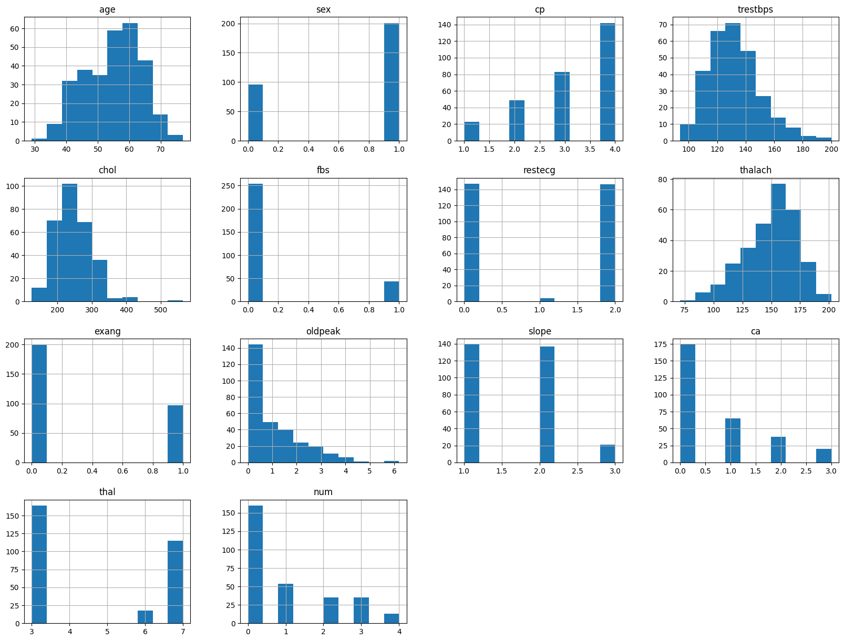
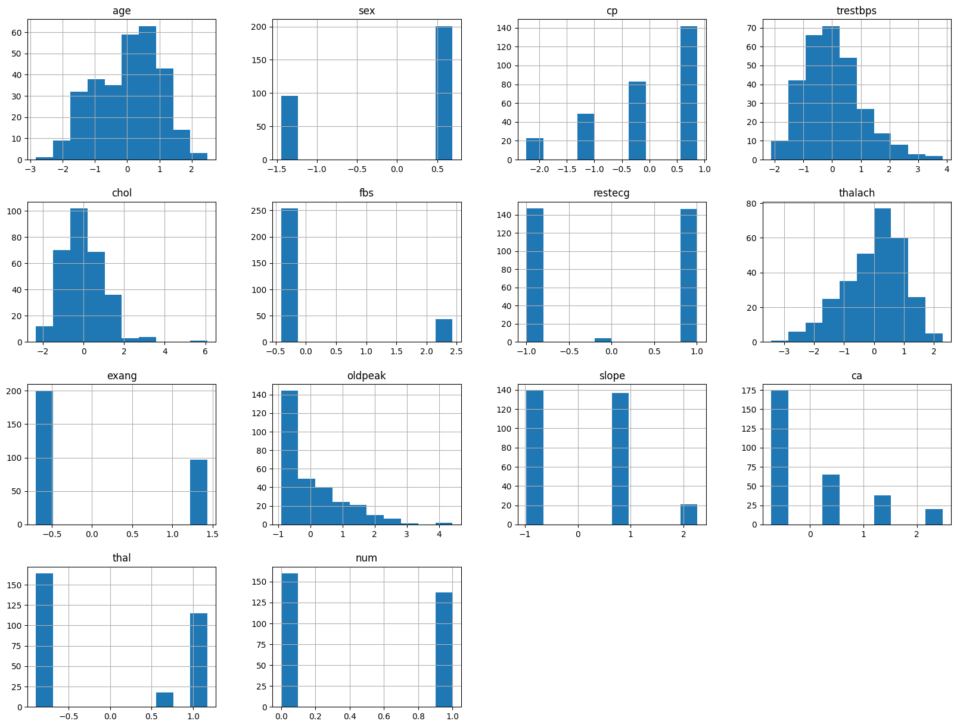
2.4. Understanding Data and Normalization
Feature Normalization (Standard Scaler)
Equalizes feature influence.
Accelerates gradient-based convergence.
before
after

Slide 13
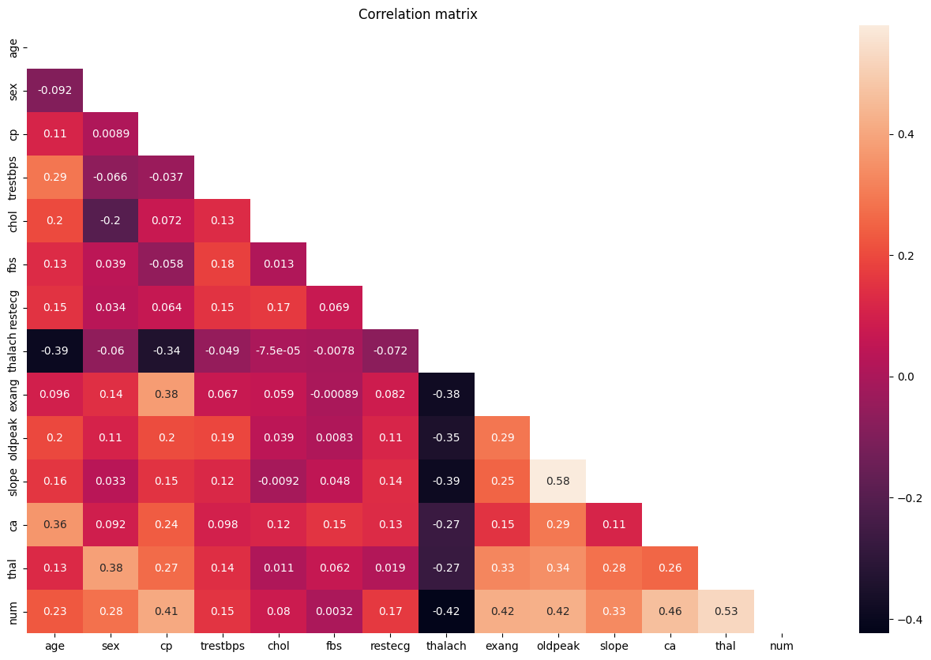
2.4. Understanding Data and Normalization
Correlation Analysis
Key Clinical Features

Slide 14
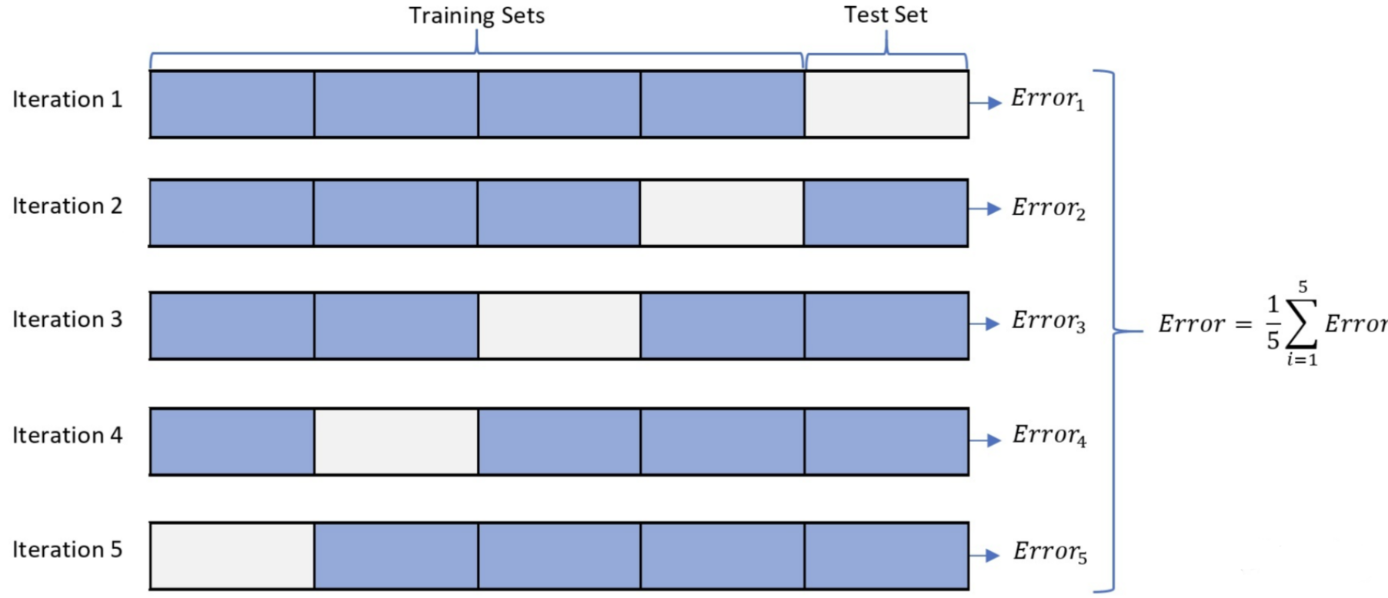
2.4. Understanding Data and Normalization
Train Test Split
Train (80%) | Test (20%)
Training Set: Model training and cross-validation (5-Fold)
Independent Test Set: Final model evaluation

Slide 15
2.5. Modeling
Evaluate Metrics
Metric | Formula | Clinical Significance
Accuracy | (TP + TN) / (TP + TN + FP + FN) | Overall proportion of correct predictions. Useful for balanced datasets.
Precision | TP / (TP + FP) | Measures reliability of positive predictions. High precision reduces false alarms.
Recall | TP / (TP + FN) | Ability to detect true cases. Critical for not missing high-risk patients.
F1-Score | 2(Precision*Recall)/(Precision+Recall) | Balances precision and recall. Ideal for evaluating clinical decision-making.
These metrics provide complementary insights, particularly crucial in the presence of class imbalance typically observed in medical datasets.

Slide 16
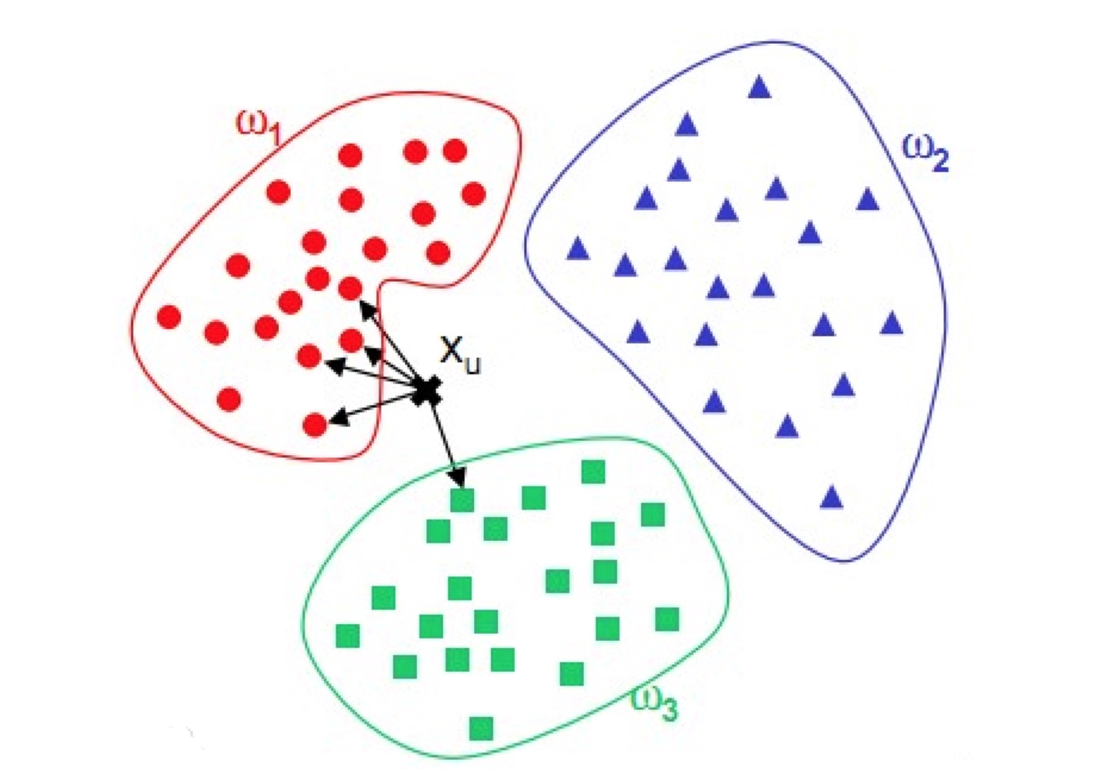
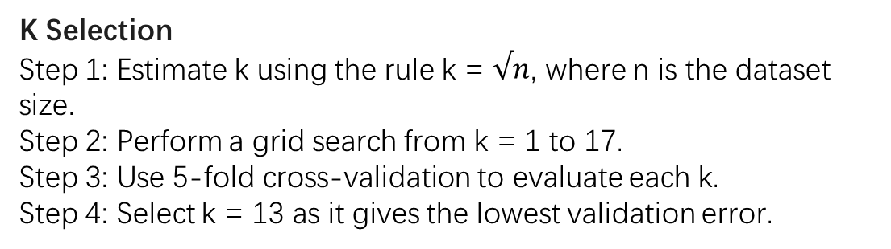
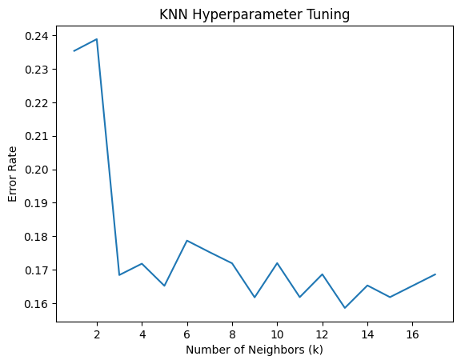
2.5. Modeling
2.5.1 KNN
The k-nearest neighbors (KNN) algorithm is a non-parametric, supervised learning classifier, which uses proximity to make classifications or predictions about the grouping of an individual data point.

Slide 17
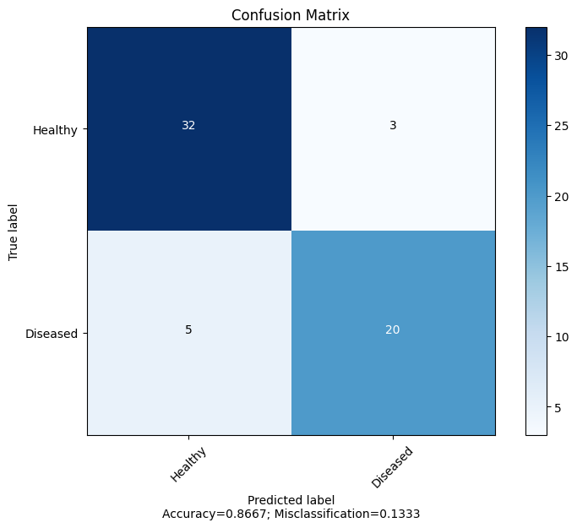
2.5. Modeling
2.5.1 KNN
result
Metric | Value
Accuracy | 0.8667
Precision | 0.8696
Recall | 0.8000
F1 | 0.8333

Slide 18
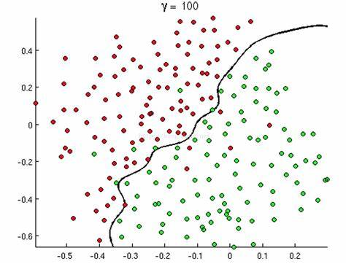
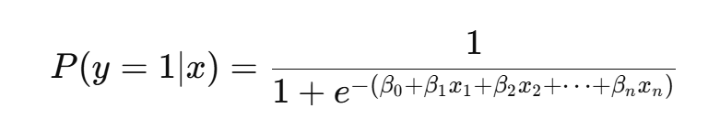
2.5 Modeling
2.5.2 Logistic Regression
Step1: Maps a linear combination of features to the (0,1) interval using the Sigmoid function:
Step2: Cross Validate (5-Fold)
Logistic regression is a supervised machine learning algorithm widely used for binary classification tasks

Slide 19

2.5. Modeling
2.5.1 Logistic Regression
result
Metric | Value
Average Accuracy | 0.9000
Average Precision | 0.9130
Average Recall | 0.8400
Average F1 | 0.8750

Slide 20
03
Result

Slide 21
3.1 Model Comparison
Comparison
Metric | KNN | Logistic Regression
Accuracy | 0.8667 | 0.9000
Precision | 0.8696 | 0.9130
Recall | 0.8000 | 0.8400
F1 Score | 0.8333 | 0.8750
Logistic Regression is better

Slide 22
3.2 Feature Coefficients
After training the model, we obtained the following feature coefficients:
The coefficient of "age" is -0.0983
The coefficient of "sex" is 0.5754
The coefficient of "cp" (chest pain type) is 0.5362
The coefficient of "trestbps" (resting blood pressure) is 0.3904
The coefficient of "chol" (serum cholesterol) is 0.2350
The coefficient of "fbs" (fasting blood sugar) is -0.3246
The coefficient of "restecg" (resting electrocardiographic results) is 0.2370
The coefficient of "thalach" (maximum heart rate achieved) is -0.4492
The coefficient of "exang" (exercise induced angina) is 0.4213
The coefficient of "oldpeak" (depression induced by exercise relative to rest) is 0.3000
The coefficient of "slope" (slope of the peak exercise ST segment) is 0.3229
The coefficient of "ca" (number of major vessels colored by fluoroscopy) is 1.1044
The coefficient of "thal" (thalassemia) is 0.6529
The intercept is -0.07983.

Slide 23
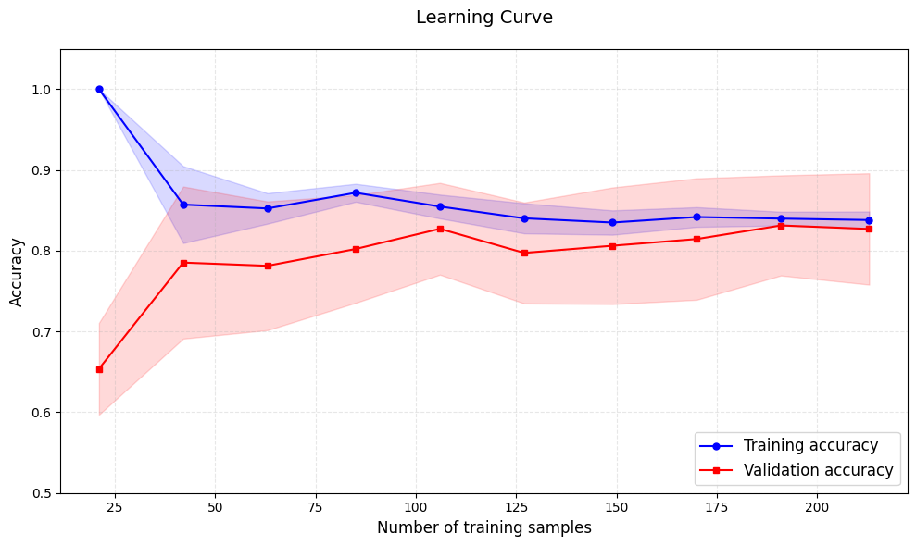
3.2 Learning Curve
Learning Curve for Logistic Regression
Both the training accuracy and validation accuracy converge towards each other, the model is generalizing well to unseen data.

Slide 24

04
Future Works

Slide 25
4. Future Works
Limitations
The dataset is mainly composed of patients from Western populations. Limited generalizability to other ethnic groups (e.g., Thai population)
These models are based on traditional machine learning algorithms, insufficient when dealing with complex time-series data.
Future Works
Apply transfer learning or data augmentation using local patient data, enhance model fairness and adaptability to diverse populations.
Deep Learning Integration: Explore Transformer-based architectures for sequential data.

Slide 26
Thanks

Slide 27
Q & A

